Slide 1

ONLINE SHOPPING

Slide 2

Online shopping is when you buy products or services through websites or mobile apps instead of going to a physical store. You can buy anything: clothes, electronics, groceries, books, even food!

Slide 3

HOW TO SHOP ONLINE?
Step 1: Choose What You Want to Buy
Think about what you need: clothes, gadgets, groceries, etc.
Make a list of the items you want.

Slide 4

Step 2: Pick a Reliable Website or App
Some popular shopping sites/apps in India:
Amazon, Flipkart, Myntra, BigBasket, Snapdeal, JioMart, etc.
Make sure the website is secure. Look for a padlock symbol (🔒) in the URL bar, which means it’s safe.

Slide 5
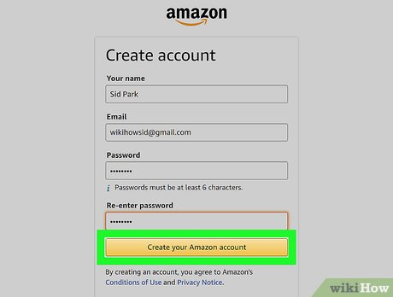
Step 3: Create an Account (If Needed)
To shop, you might need to sign up with your email, phone number, and password.
Some sites let you shop without an account, but creating one helps you track orders.

Slide 6

Step 4: Search for the Product
Use the search bar at the top of the website or app.
Type what you’re looking for, like “Bluetooth headphones” or “red running shoes.”

Slide 7
Step 5: Check Product Details
Click on the product to see:
Product images (to see how it looks)
Price
Description (features, size, color, etc.)
Reviews (what other buyers say)

Slide 8
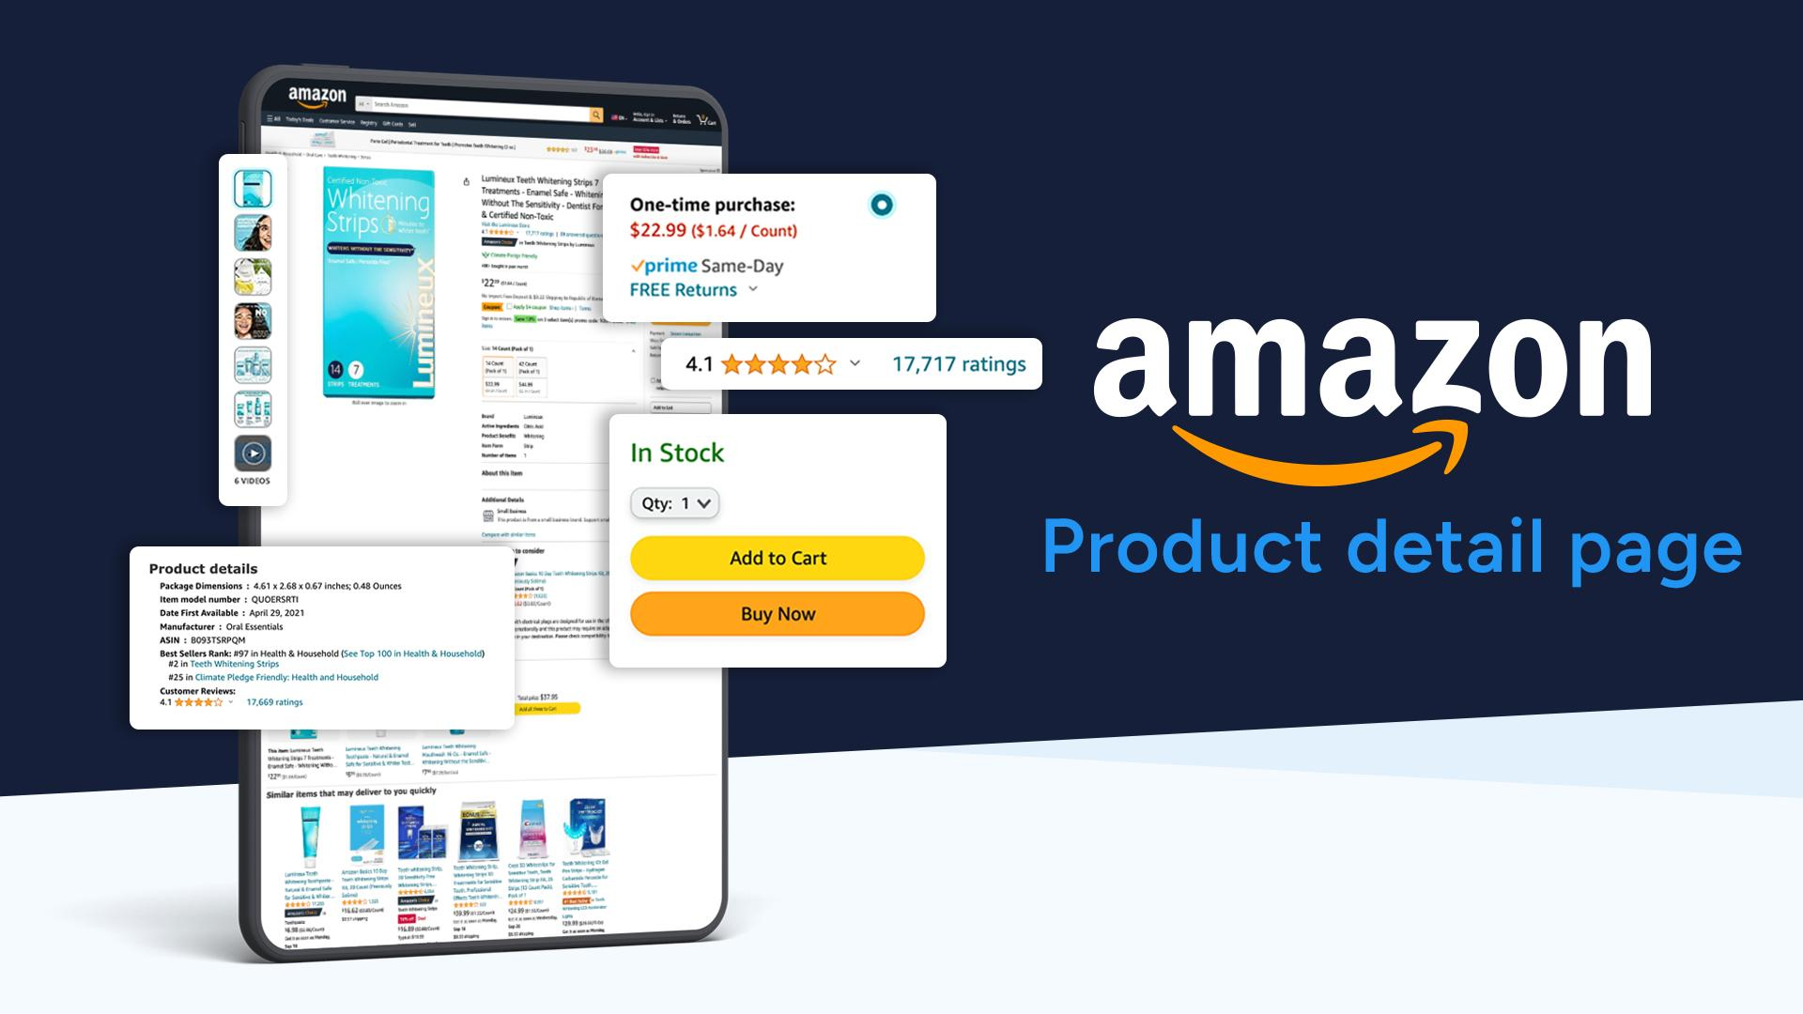

Slide 9
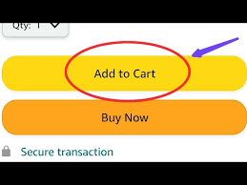
Step 6: Add to Cart
If you like the product, click “Add to Cart”.
Your cart is like a shopping bag where all the items you want are saved.

Slide 10

Step 7: Review Your Cart
Go to the cart (usually a shopping bag icon 🛍️).
Check if everything is correct:
Right size, color, quantity, etc.
If you want to remove or add more items, you can do that here.

Slide 11
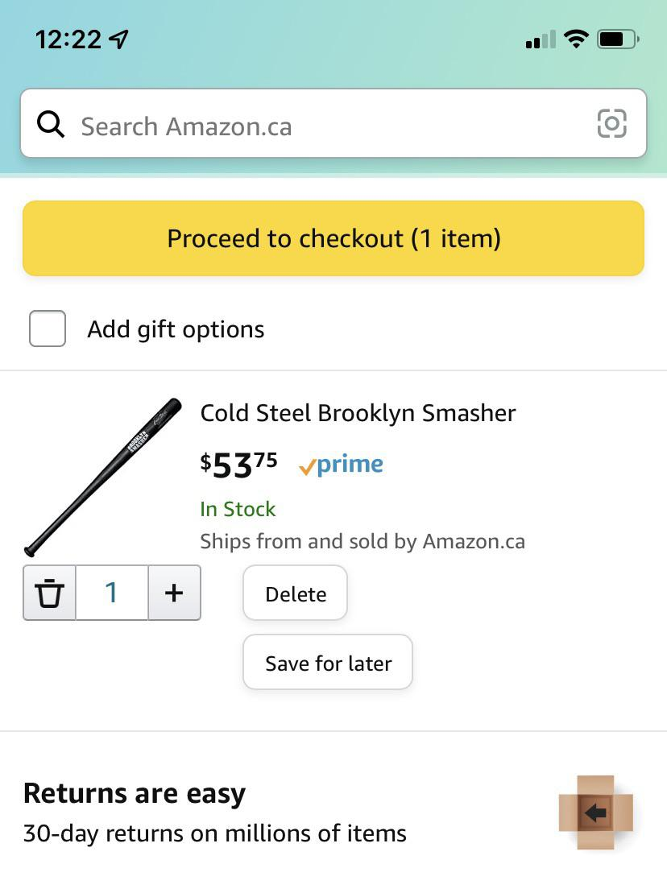
Step 8: Proceed to Checkout
Click on “Proceed to Checkout” when you’re ready to buy.
Enter your shipping address (where you want the item delivered).
Choose a payment method (more on this below).

Slide 12
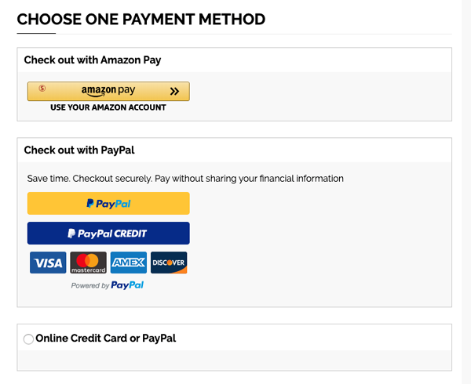
Step 9: Choose a Payment Method
You can pay in several ways:
Cash on Delivery (COD):
You pay when the product is delivered to your home.
Best if you don’t have online payment options.
Online Payment (Credit/Debit Card, UPI, Net Banking):
Enter your card details or UPI ID.
Use secure payment gateways—you’ll often get an OTP (One-Time Password) to confirm.

Slide 13
Mobile Wallets:
Use apps like Paytm, PhonePe, Google Pay to pay quickly.
EMI (Easy Monthly Installments):
If the item is expensive, you can pay in monthly installments (if eligible).

Slide 14
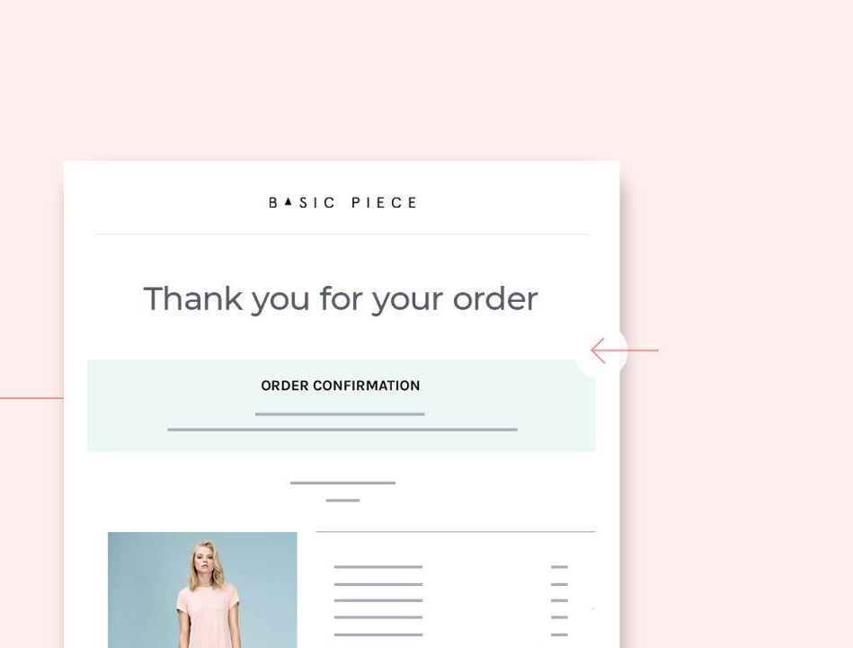
Step 10: Confirm & Place Your Order
Review everything:
Product details
Address
Payment method
Click “Place Order”.
You’ll get an order confirmation with an estimated delivery date.

Slide 15
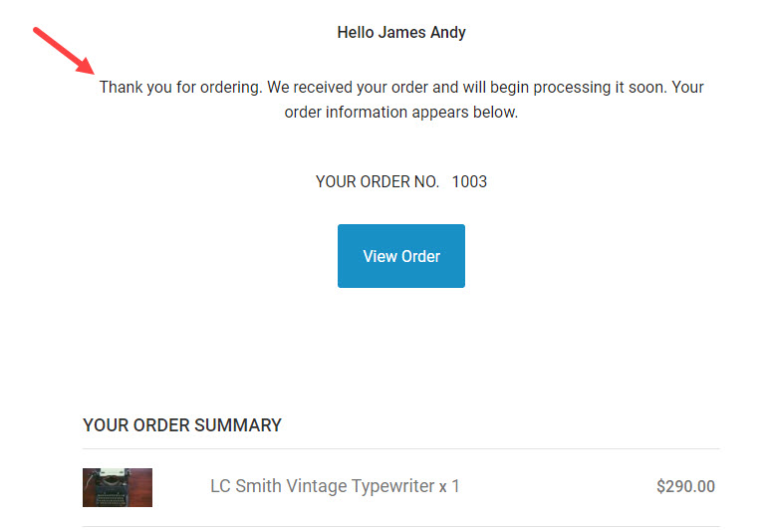
Step 11: Track Your Order
After ordering, go to your account and check “My Orders”.
You can track your package in real-time and see when it’s out for delivery.

Slide 16

Step 12: Receive the Product
When the delivery person comes, check the package:
Is it in good condition?
Is it the right product?
If everything is okay, accept the package.
If you paid by COD, pay the delivery person.

